Slide 1
Simple Solution. Brighter Futures.
Overview of TEAL

Slide 2
TEAL
TEAL – Texas Education Agency Login
A single sign-on that provides users access to many TEA applications
Secure authentication ensures only authorized users can access the applications
Users must first create a TEAL identity and then request account access to the specific applications needed

Slide 3
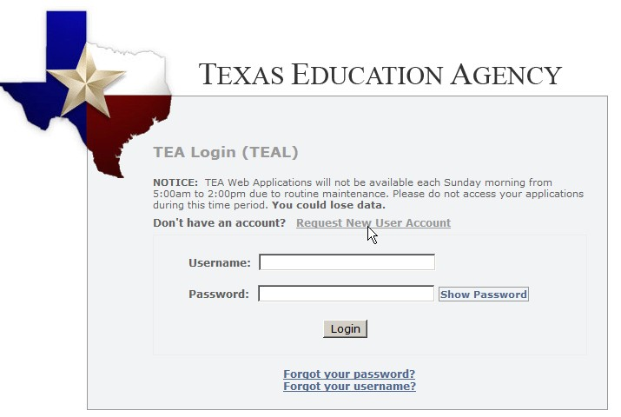
Requesting a TEAL User Account (TEAL ID)
To begin a request for a TEAL ID, the user must click the link on the TEAL login page.
https://tealprod.tea.state.tx.us/
Refer to “Requesting a TEAL User ID”

Slide 4
TEAL Account Access and Approval Process
13
Once a TEAL ID is created, the user must request access to the specific TEA applications to which they need access.
If a request for account access is not made within 90 days, the TEAL account is inactivated.
Requests for account access approvals are routed for Organizational approval as follows:
Limited Approver (e.g. approves TSDS Portal Requests only) (5 days)*
Alternate Approver (e.g., approves all org request) (5 days)*
Primary Approver (e.g. Exec. Dir. or Superintendent approves all org requests) (5 days)
Once requests are approved at the organization level, they are routed to the TEA Service Approver for approval
* - Optional

Slide 5
Key Features
New rules for suspending TEAL user accounts / access
User accounts with no application access suspended in 90 days, eventually deleted
User accounts with no logon activity suspended after 18 months then eventually deleted (longer for Educators)

Slide 6
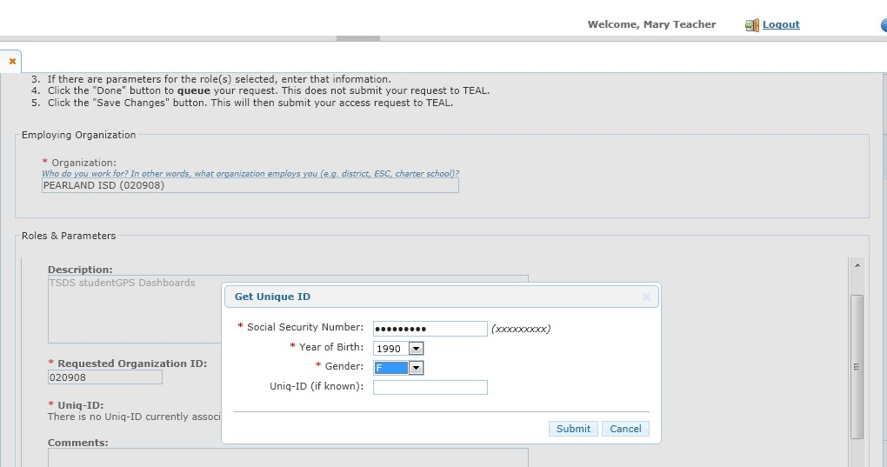
Unique ID Lookup in TEAL

Slide 7
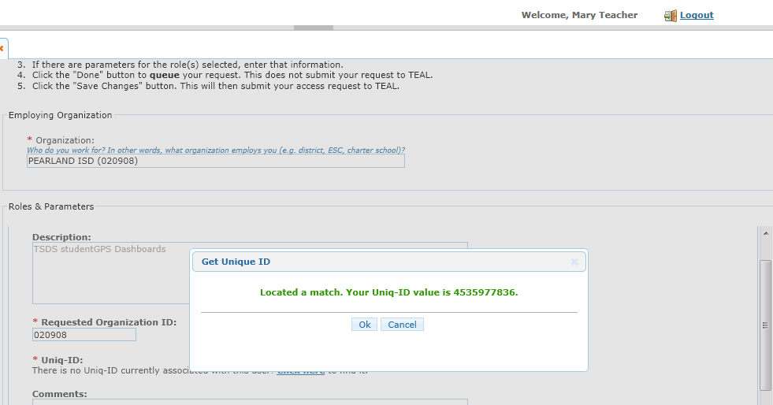
Unique ID Lookup in TEAL

Slide 8
Questions?

